Slide 1
Optimized Implementation of Quantum Binary Field Multiplication with Toffoli Depth One
Kyungbae Jang, Wonwoong Kim, Sejin Lim, Yeajun Kang,
Yu-Jin Yang, and Hwajeong Seo

Slide 2
Contents
Our Contribution
Background & Related Work
Proposed Method
Performance & Evaluation
Conclusion & Future work

Slide 3
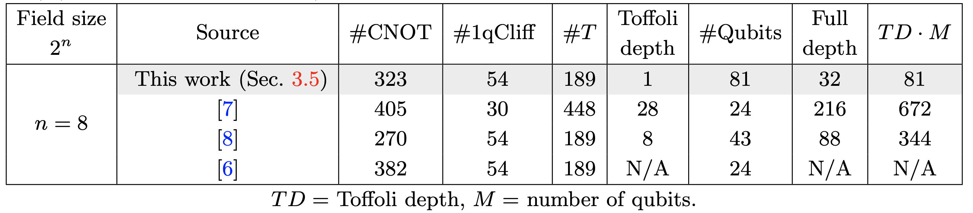
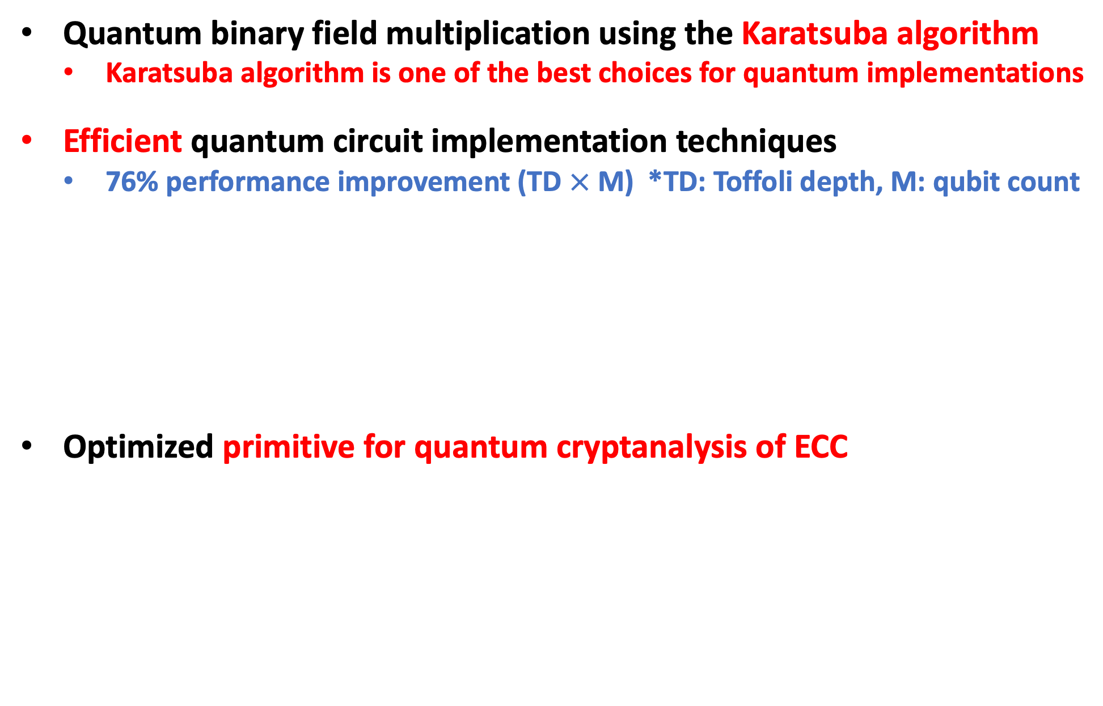
Our Contribution
Quantum binary field multiplication using the Karatsuba algorithm
Karatsuba algorithm is one of the best choices for quantum implementations
Efficient quantum circuit implementation techniques
76% performance improvement (TD $×$ M) *TD: Toffoli depth, M: qubit count
Optimized primitive for quantum cryptanalysis of ECC

Slide 4
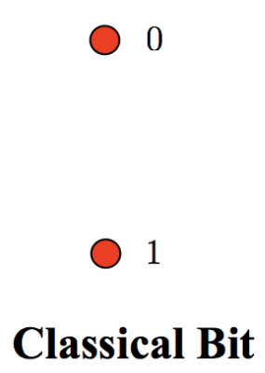
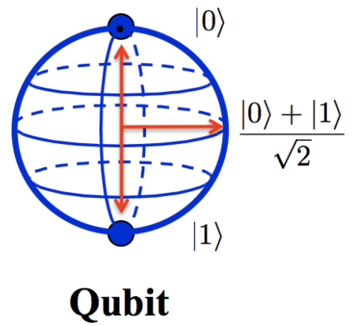
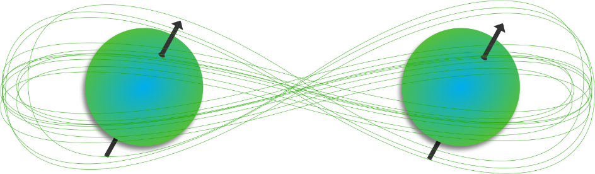

Quantum Computing
Qubit (Quantum bit)
Superposition
Entanglement

Slide 5
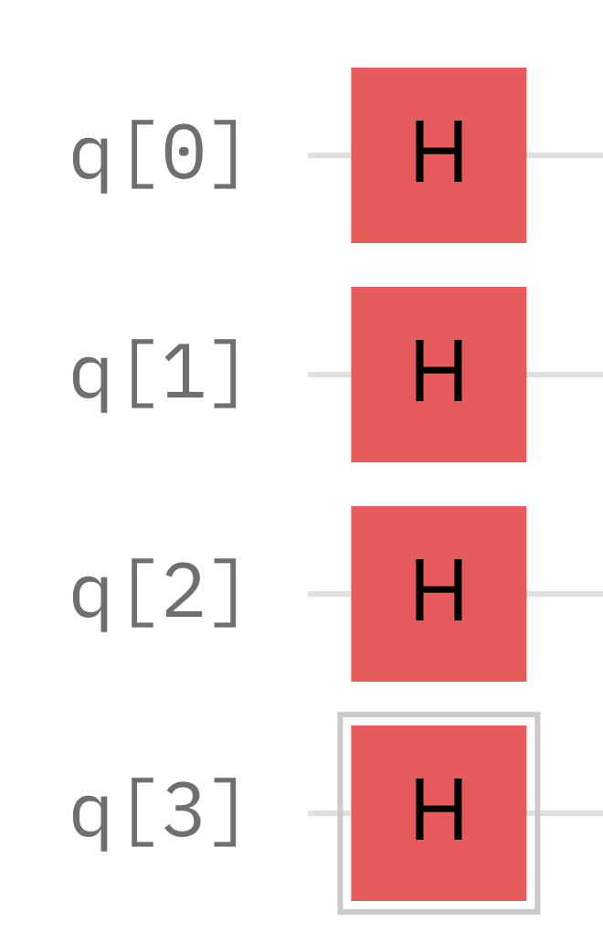
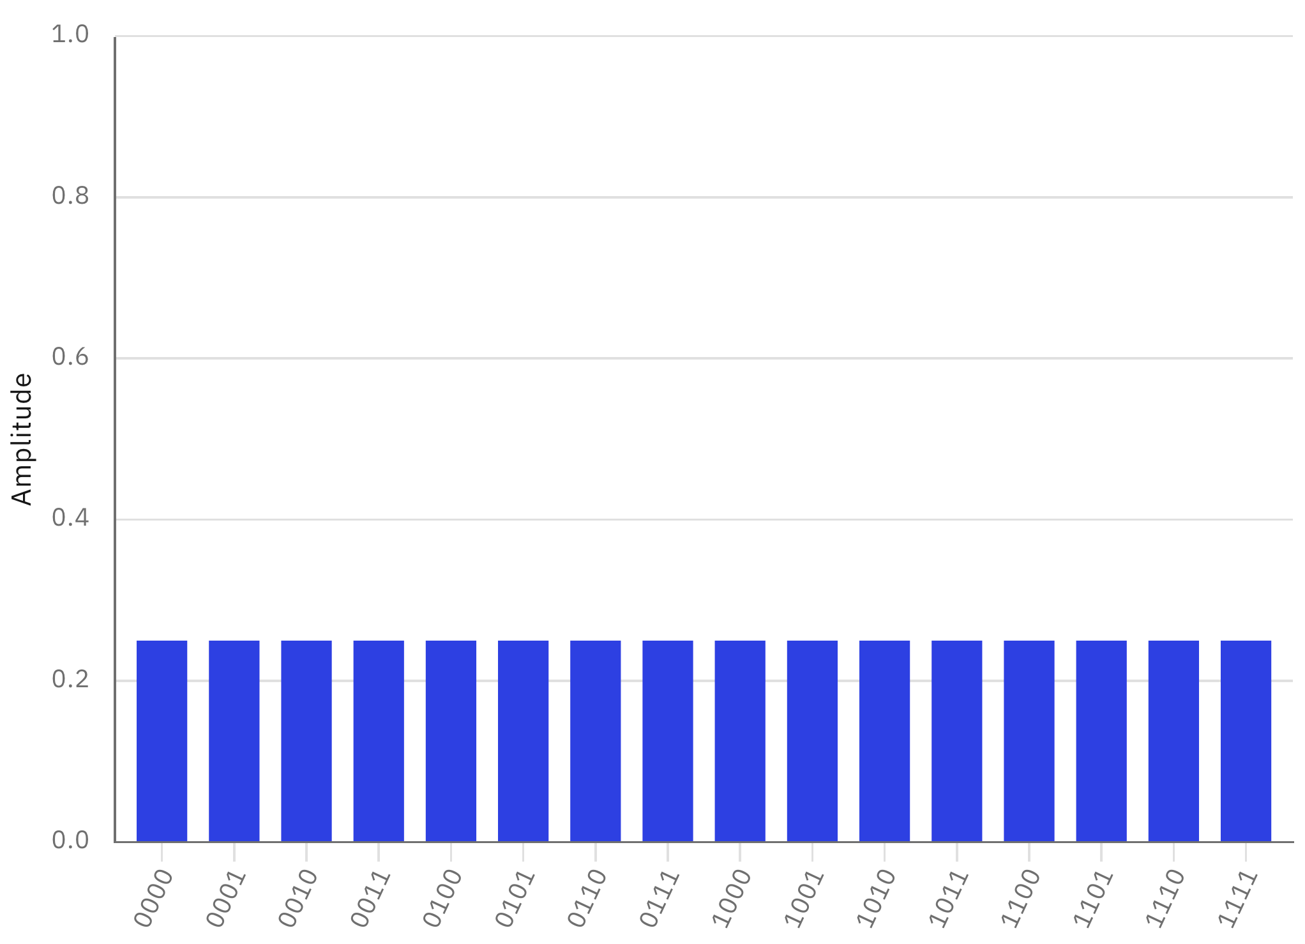
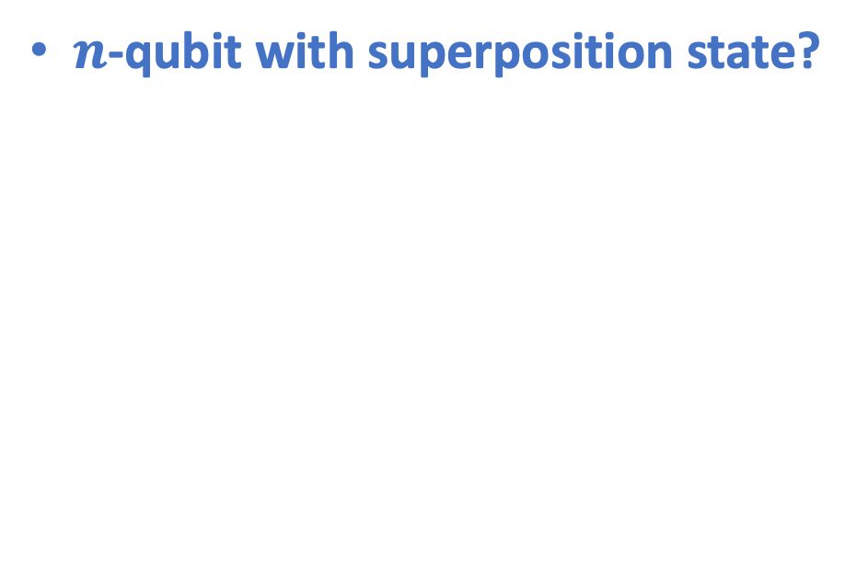
Quantum Computer
$n$-qubit with superposition state?
We can prepare $2^{n}$ states (as probability) at once!
With proper quantum algorithm? (Shor, Grover, Simon etc…)
→ Meaningful result can be achieved

Slide 6
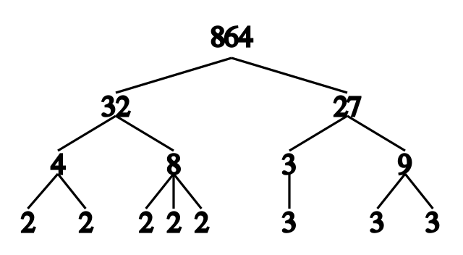
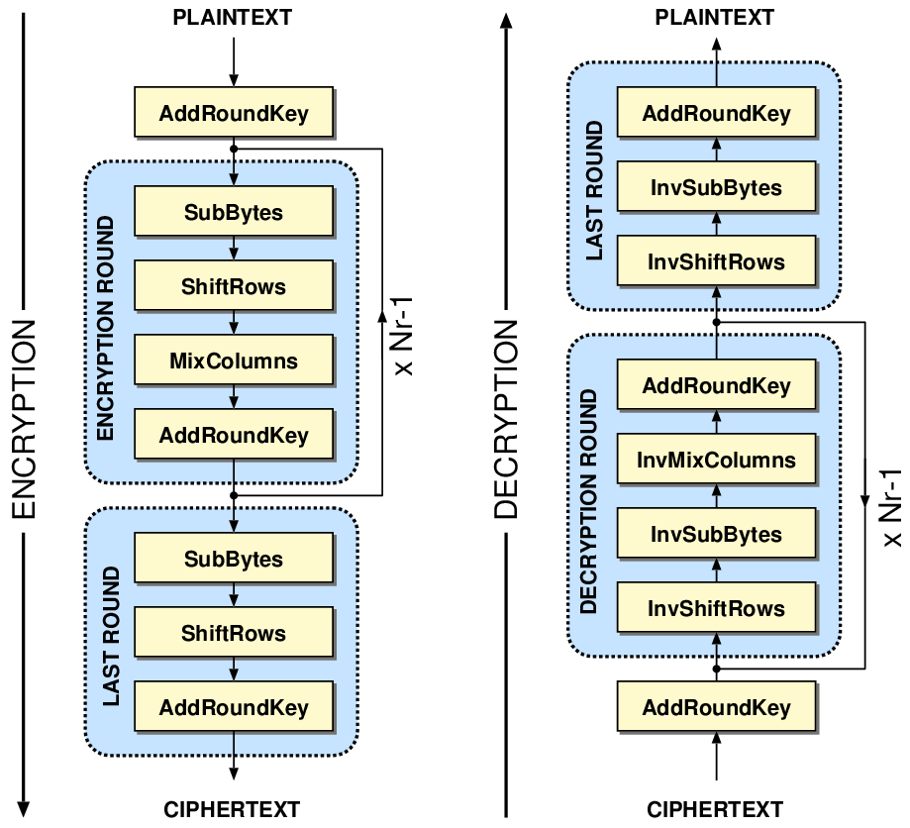

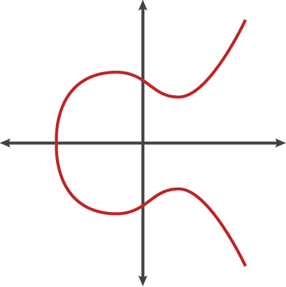
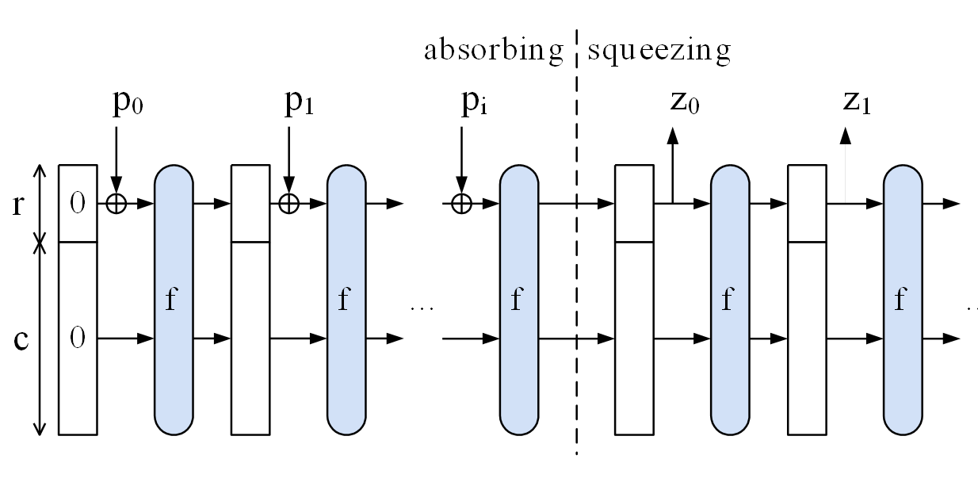
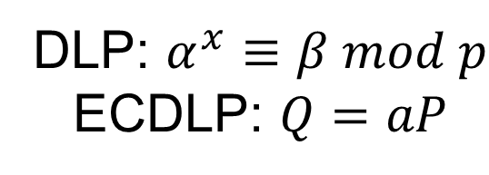
Cryptosystems in Quantum World
Shor’s Algorithm
Grover’s Algorithm
DLP: $α^{x}≡β mod p$
ECDLP: $Q=aP$

Slide 7
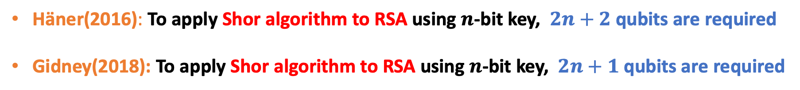
Shor on RSA
Häner(2016): To apply Shor algorithm to RSA using $n$-bit key, $2n+2$qubits are required
Gidney(2018): To apply Shor algorithm to RSA using $n$-bit key, $2n+1$qubits are required
 |  | Häner (2016) | Gideny (2018)
Qubits | RSA-3072 | 6,146 | 6,145
 | RSA-7680 | 15,362 | 15,361
 | RSA-15630 | 30,722 | 30,271
< Comparison of resources (Shor on RSA factorization problem)>
Thomas Häner, M. Rötteler, K. Svore”, Factoring using 2n+2 qubits with Toffoli based modular multiplication, 2016
Craig Gidney, “Factoring with n + 2 clean qubits and n − 1 dirty qubits”, 2018

Slide 8
Shor on ECDLP (Elliptic Curve Discrete Logarithmic Problems)
Shor algorithm on ECDLP
NIST curves target
ASIACRYPT(2017) : “Quantum resource estimates for computing elliptic curve discrete logarithms”
Estimate the quantum resources required to solve the DLP in the elliptic curve
RSA is more vulnerable to quantum attacks than ECC
PQCrypto(2020) : “Improved quantum circuits for elliptic curve discrete logarithms”
They further reduced quantum resources (qubits, depth) than results of ASIACRYPT.
CHES (2020) : “Concrete quantum cryptanalysis of binary elliptic curves”
Shows that the Shor algorithm for binary ECC can be attacked with fewer resources.

Slide 9
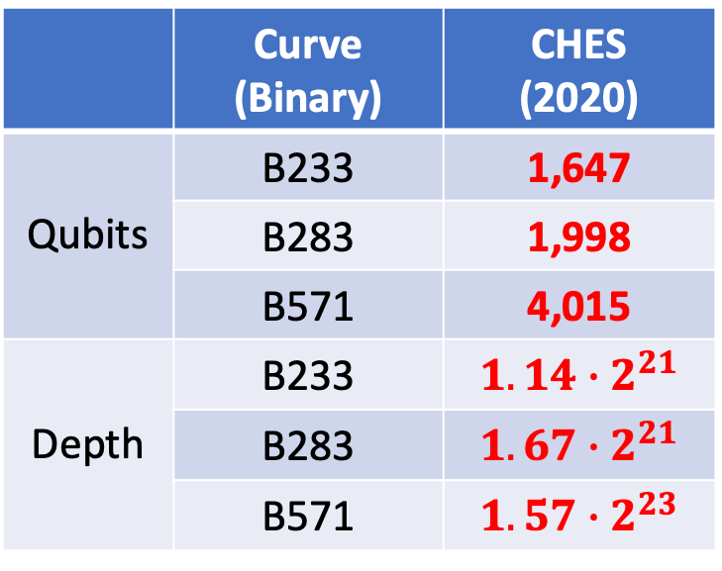
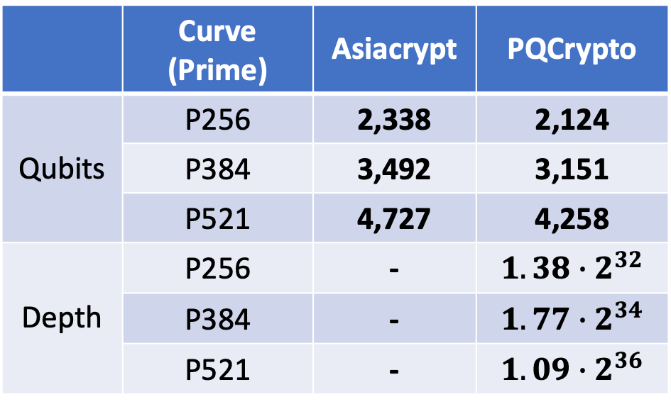
Shor on ECDLP (Elliptic Curve Discrete Logarithmic Problems)
CHES 2020 paper results show the least resource-consuming quantum attack
They targeted Binary curves, Not Prime curves(ASIACRYPT, PQCrypto)
Since Binary arithmetic (Hardware-friendly ) is used, it is also optimized on quantum computers
Binary addition → XOR operation, Binary multiplication → AND operation, no carry
 | Curve (Prime) | Asiacrypt | PQCrypto
Qubits | P256 | 2,338 | 2,124
 | P384 | 3,492 | 3,151
 | P521 | 4,727 | 4,258
Depth | P256 | - | $1.38∙$ $2^{32}$
 | P384 | - | $1.77∙$ $2^{34}$
 | P521 | - | $1.09∙$ $2^{36}$
 | Curve (Binary) | CHES (2020)
Qubits | B233 | 1,647
 | B283 | 1,998
 | B571 | 4,015
Depth | B233 | $1.14∙$ $2^{21}$
 | B283 | $1.67∙$ $2^{21}$
 | B571 | $1.57∙$ $2^{23}$
<Quantum resources for applying Shor algorithm to ECDLP>

Slide 10
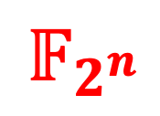

Shor on ECDLP (Elliptic Curve Discrete Logarithmic Problems)
What is the most important thig to present an optimized quantum attack?
Quantum Fourier Transformation (QFT)?, Quantum Phase Estimation (QFT)?
Essential, but default
In our understanding,
Scalar multiplication…
→ Point addition…
→ Field arithmetic…
$𝔽_{p}$,
$$𝔽_{2^{n}}$$
in Quantum!

Slide 11
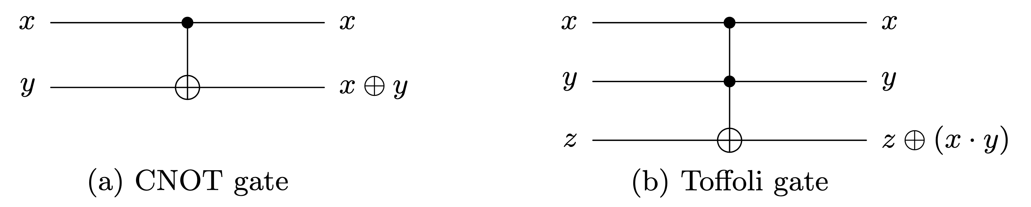
Quantum Gates
The CNOT gate replaces classical XOR operation
The Toffoli gate replaces classical AND operation

Slide 12
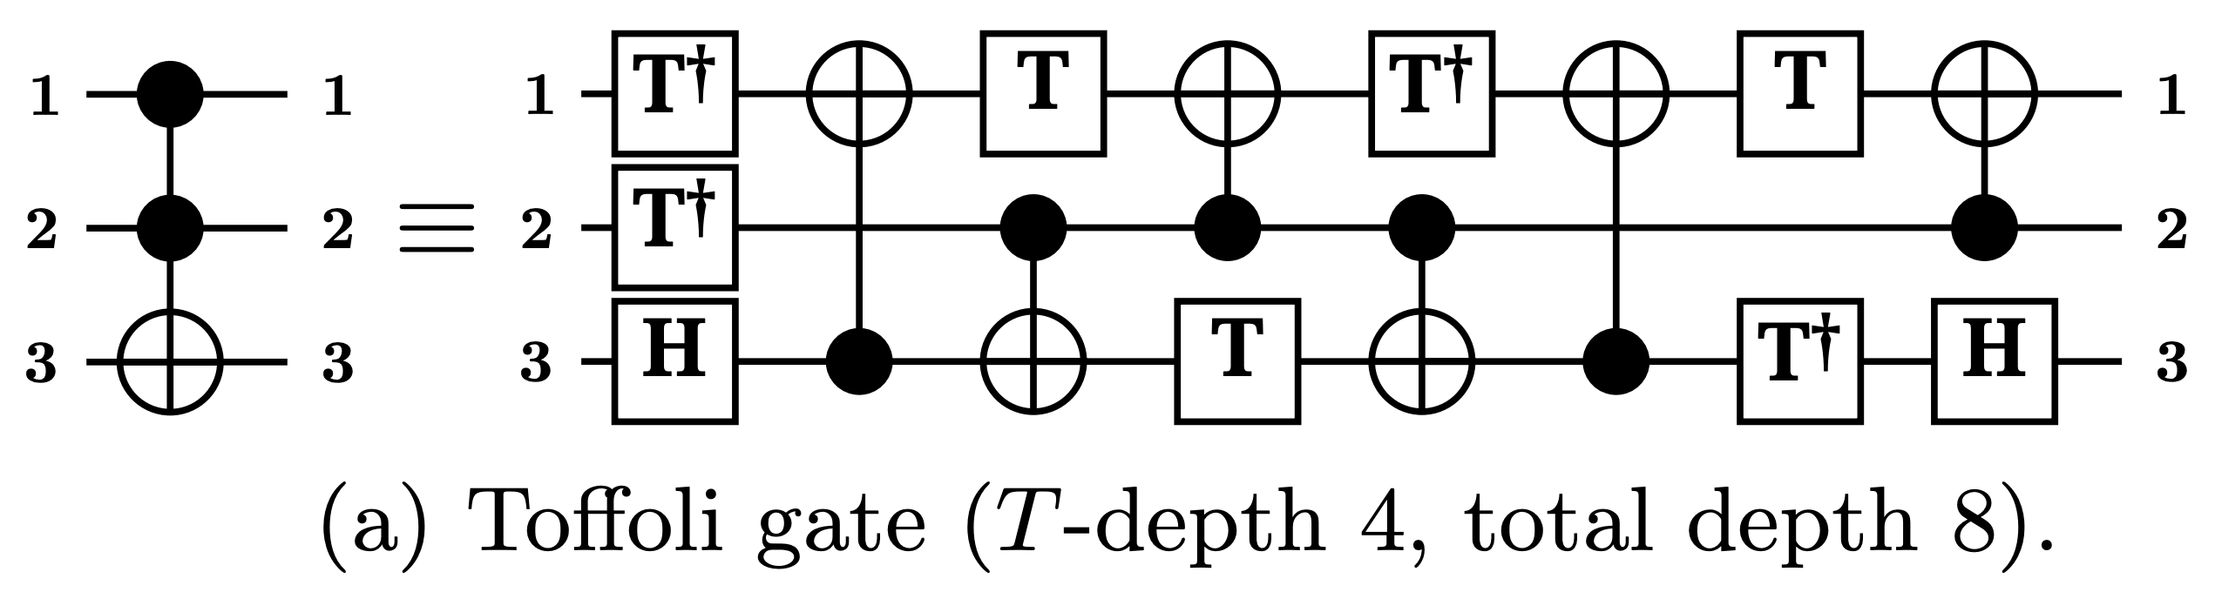
Quantum Gates
Actually, the Toffoli gates are more complex than other quantum gates
This is why we should reduce the use of Toffoli gates (depth) !!
*
*
M. Amy, D. Maslov, M. Mosca, M. Roetteler, and M. Roetteler, “A meet- in-the-middle algorithm for fast synthesis of depth-optimal quantum circuits,”

Slide 13
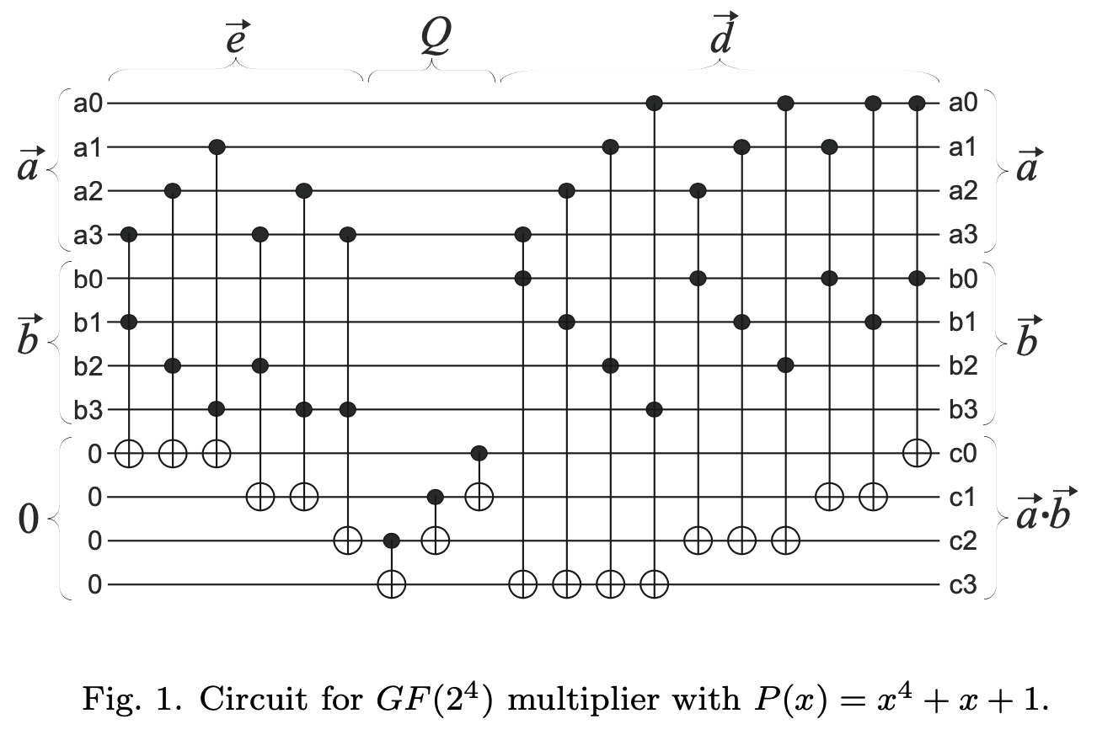
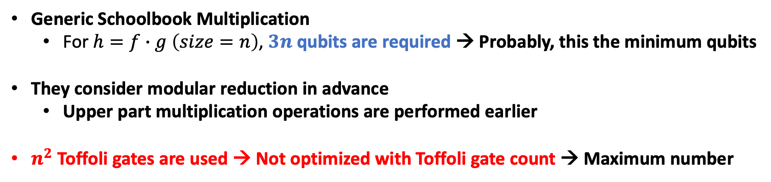
Related Work: D. Maslov et al.
Generic Schoolbook Multiplication
For $h=f∙g \left(size=n\right)$, $3n$ qubits are required → Probably, this the minimum qubits
They consider modular reduction in advance
Upper part multiplication operations are performed earlier
$n^{2}$ Toffoli gates are used → Not optimized with Toffoli gate count → Maximum number
*
* D. Maslov et al. “On the design and
optimization of a quantum polynomial
time attack on elliptic curve cryptography”
< Quantum multiplication circuit>

Slide 14
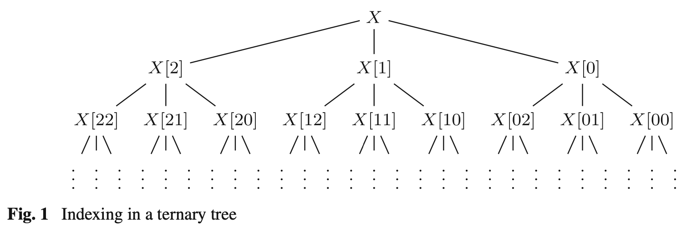
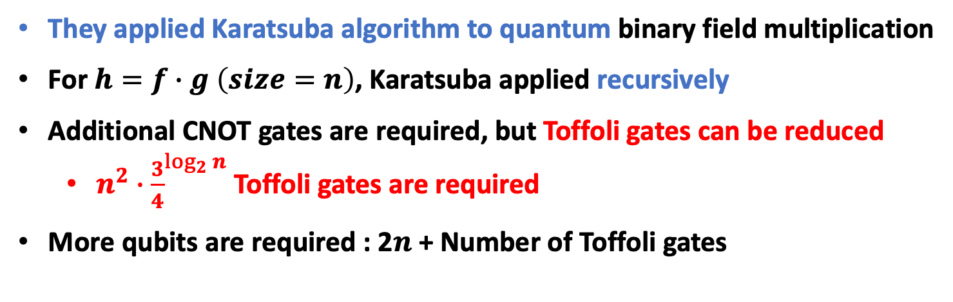
Related Work: S. Kepley et al.
They applied Karatsuba algorithm to quantum binary field multiplication
For$h=f∙g \left(size=n\right)$, Karatsuba applied recursively
Additional CNOT gates are required, but Toffoli gates can be reduced
$n^{2}∙{\frac{3}{4}}^{\log_{2}{n}}$ Toffoli gates are required
More qubits are required : 2$n$ + Number of Toffoli gates
*
< Recursive division in Karatsuba >
* S. Kepley et al, “Quantum circuits for F2n -multiplication with subquadratic gate count”

Slide 15
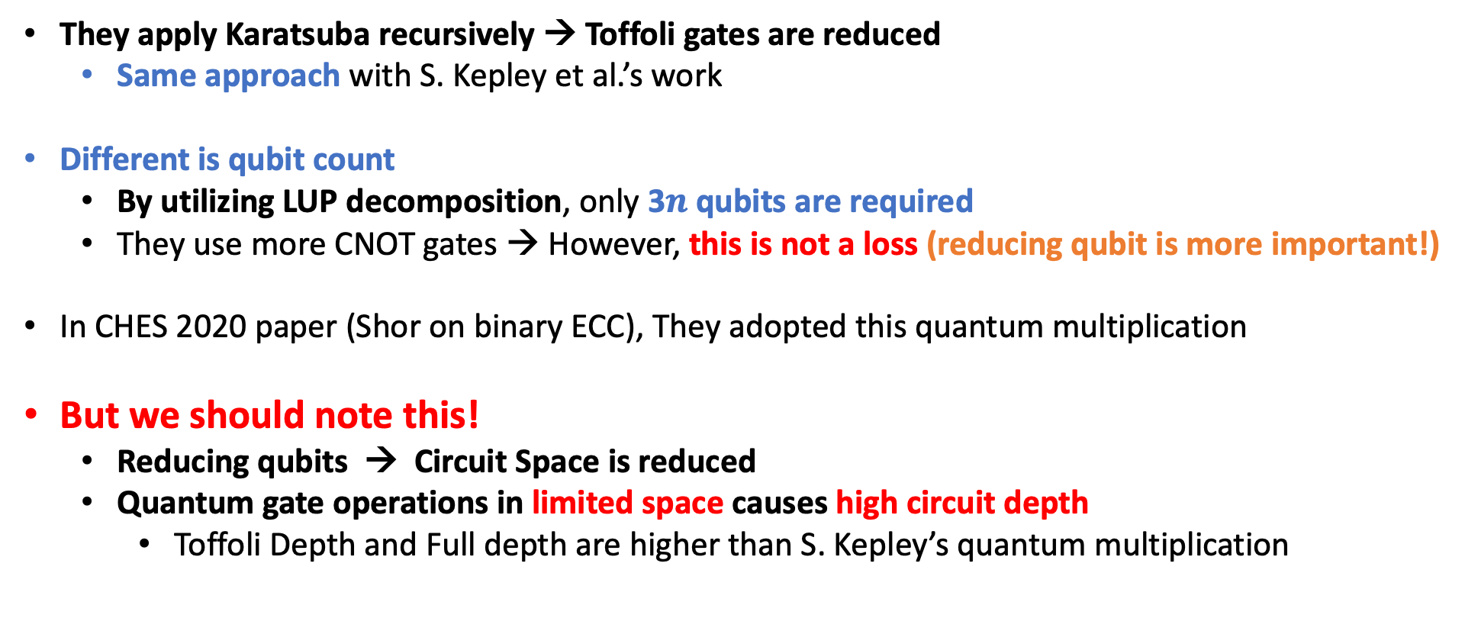
Related Work: I. van Hoof
They apply Karatsuba recursively → Toffoli gates are reduced
Same approach with S. Kepley et al.’s work
Different is qubit count
By utilizing LUP decomposition, only 3$n$ qubits are required
They use more CNOT gates → However, this is not a loss (reducing qubit is more important!)
In CHES 2020 paper (Shor on binary ECC), They adopted this quantum multiplication
But we should note this!
Reducing qubits → Circuit Space is reduced
Quantum gate operations in limited space causes high circuit depth
Toffoli Depth and Full depth are higher than S. Kepley’s quantum multiplication
We should consider carefully the tradeoff between depth and qubit count.

Slide 16
Proposed Quantum Binary Multiplication
Previous works do not consider circuit depth
Our quantum multiplication optimizes the Toffoli depth (i.e., one)
Full depth is also reduced (Full depth depends on Toffoli depth)
We also apply Karatsuba recursively
Multiplication is divided → This alone is also effective
However, we remove the dependencies in the divided multiplications
We provide rooms for removing dependencies.
When there is a dependency when dividing by Karatsuba?
We provide a room (ancilla qubits)
For any Field size $2^{n}$, we can implement quantum multiplication with Toffoli depth one

Slide 17
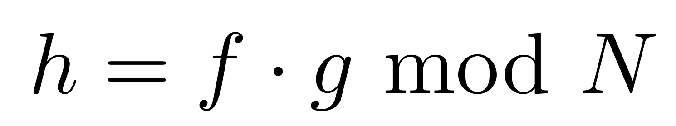
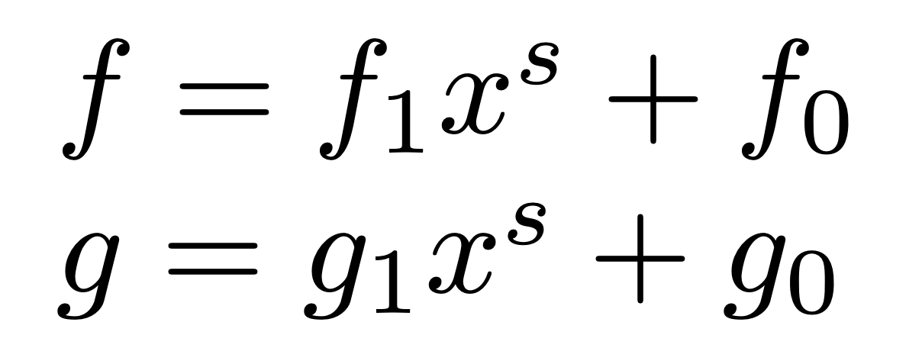
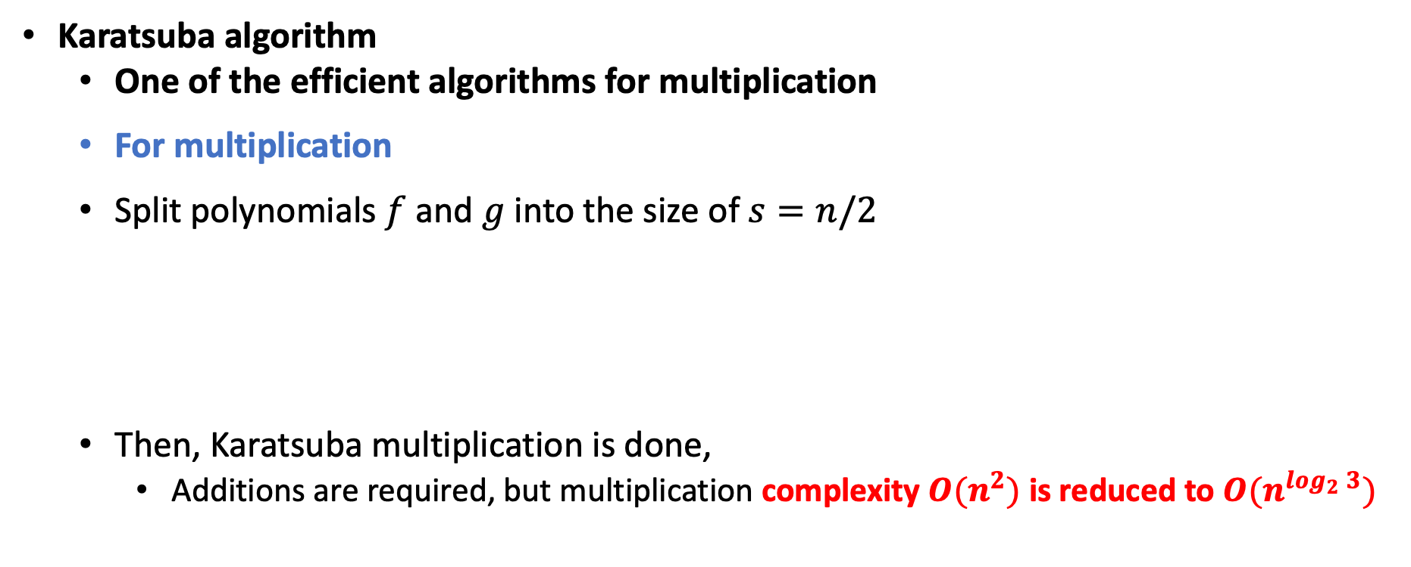
Proposed Quantum Binary Multiplication
Karatsuba algorithm
One of the efficient algorithms for multiplication
For multiplication
Split polynomials$f$ and $g$ into the size of $s=n/2$
Then, Karatsuba multiplication is done,
Additions are required, but multiplication complexity $O(n^{2})$ is reduced to ${O(n}^{\log_{2}{3}})$

Slide 18
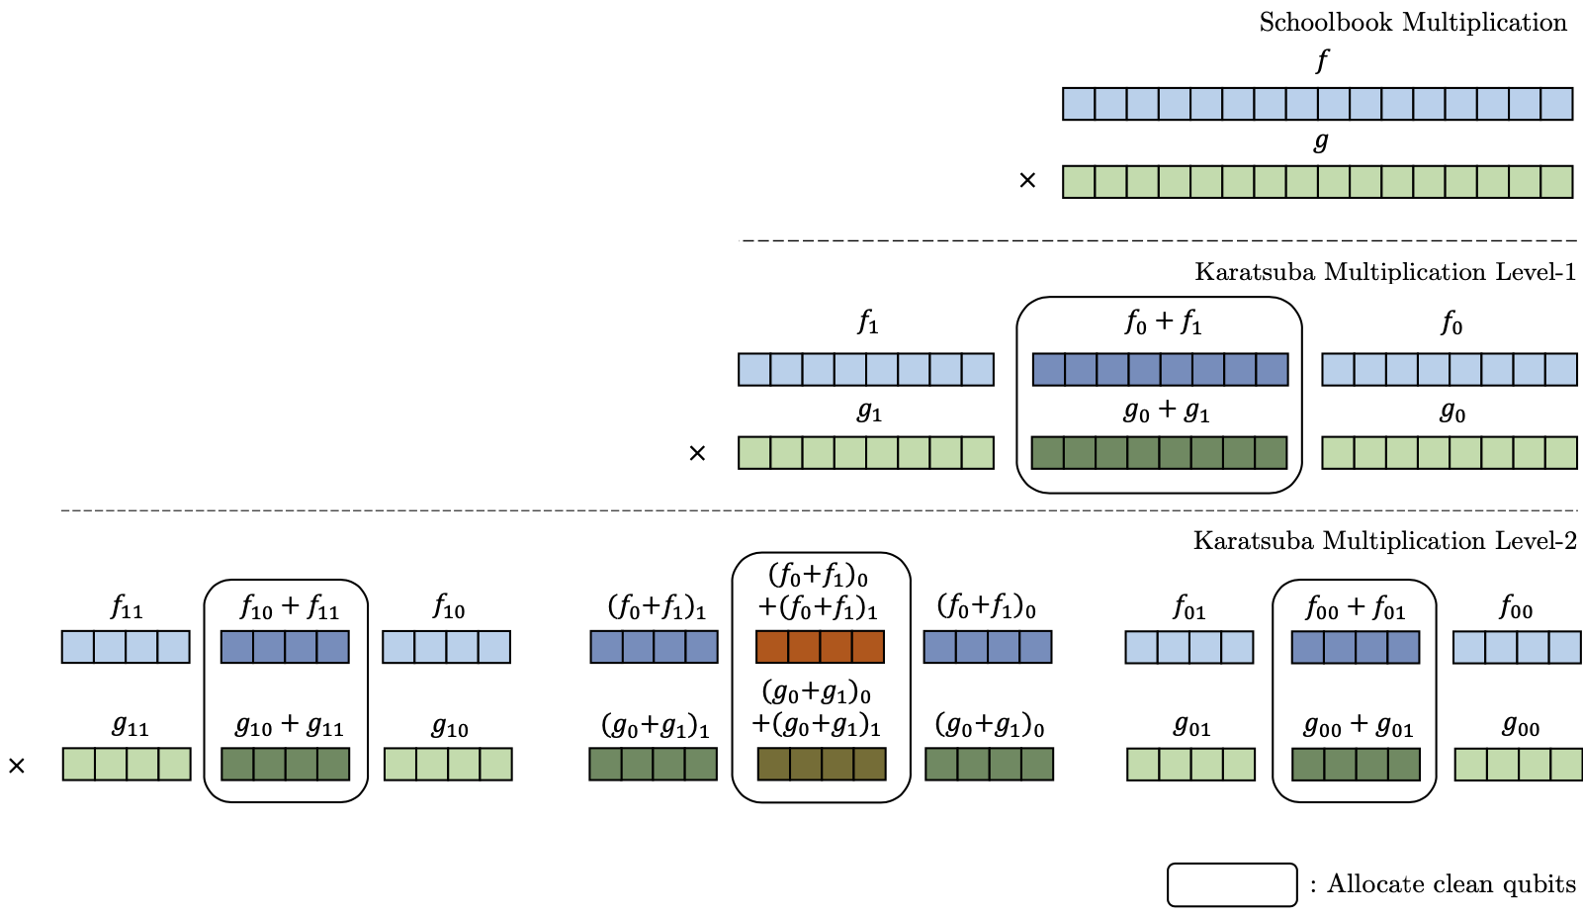
Proposed Quantum Binary Multiplication
We apply Karatsuba recursively (in quantum), Level-1, Level-2, Level-3 …
We provide rooms to remove dependencies between split multiplications (Rectangles)

Slide 19
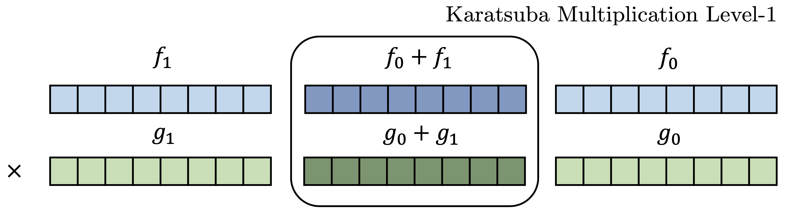
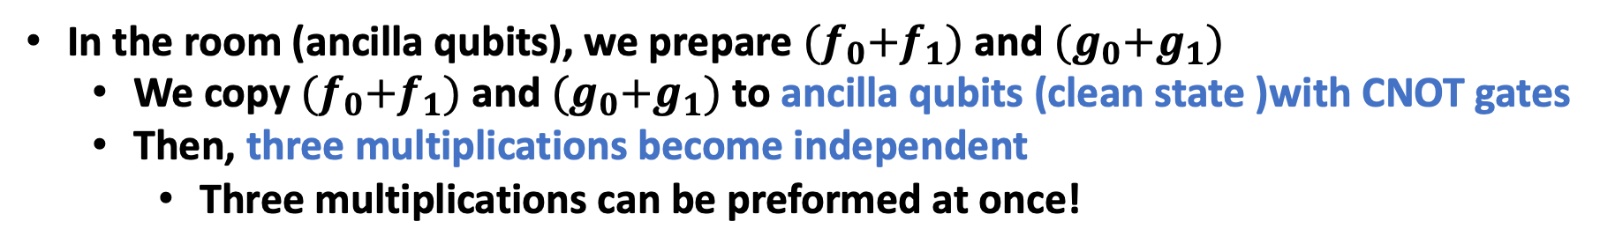
Proposed Quantum Binary Multiplication
In the room (ancilla qubits), we prepare ${(f}_{0}+f_{1})$ and ${(g}_{0}+g_{1})$
We copy ${(f}_{0}+f_{1})$ and ${(g}_{0}+g_{1})$ to ancilla qubits (clean state )with CNOT gates
Then, three multiplications become independent
Three multiplications can be preformed at once!
Ancilla qubits and CNOT gates are required

Slide 20
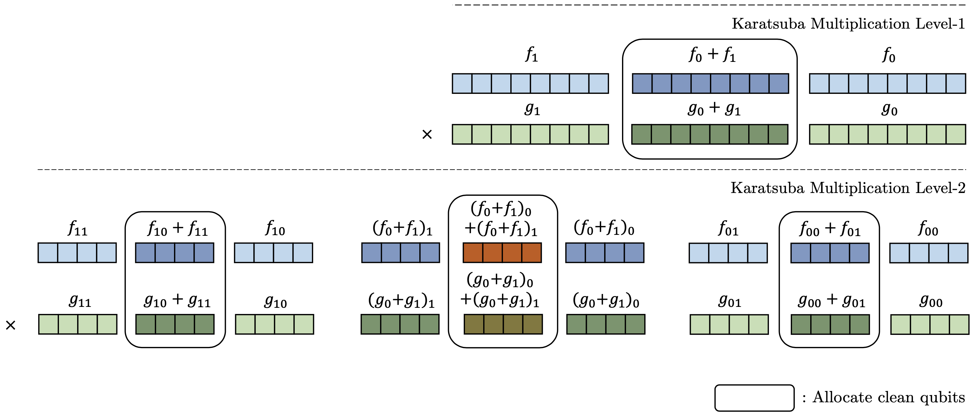

Proposed Quantum Binary Multiplication
If we apply Karatsuba recursively and provide rooms for removing dependencies
Finally, at last Karatsuba level, all products $(1×1)$ are generated at once!
→ Toffoli depth is one, and full depth is also reduced

Slide 21
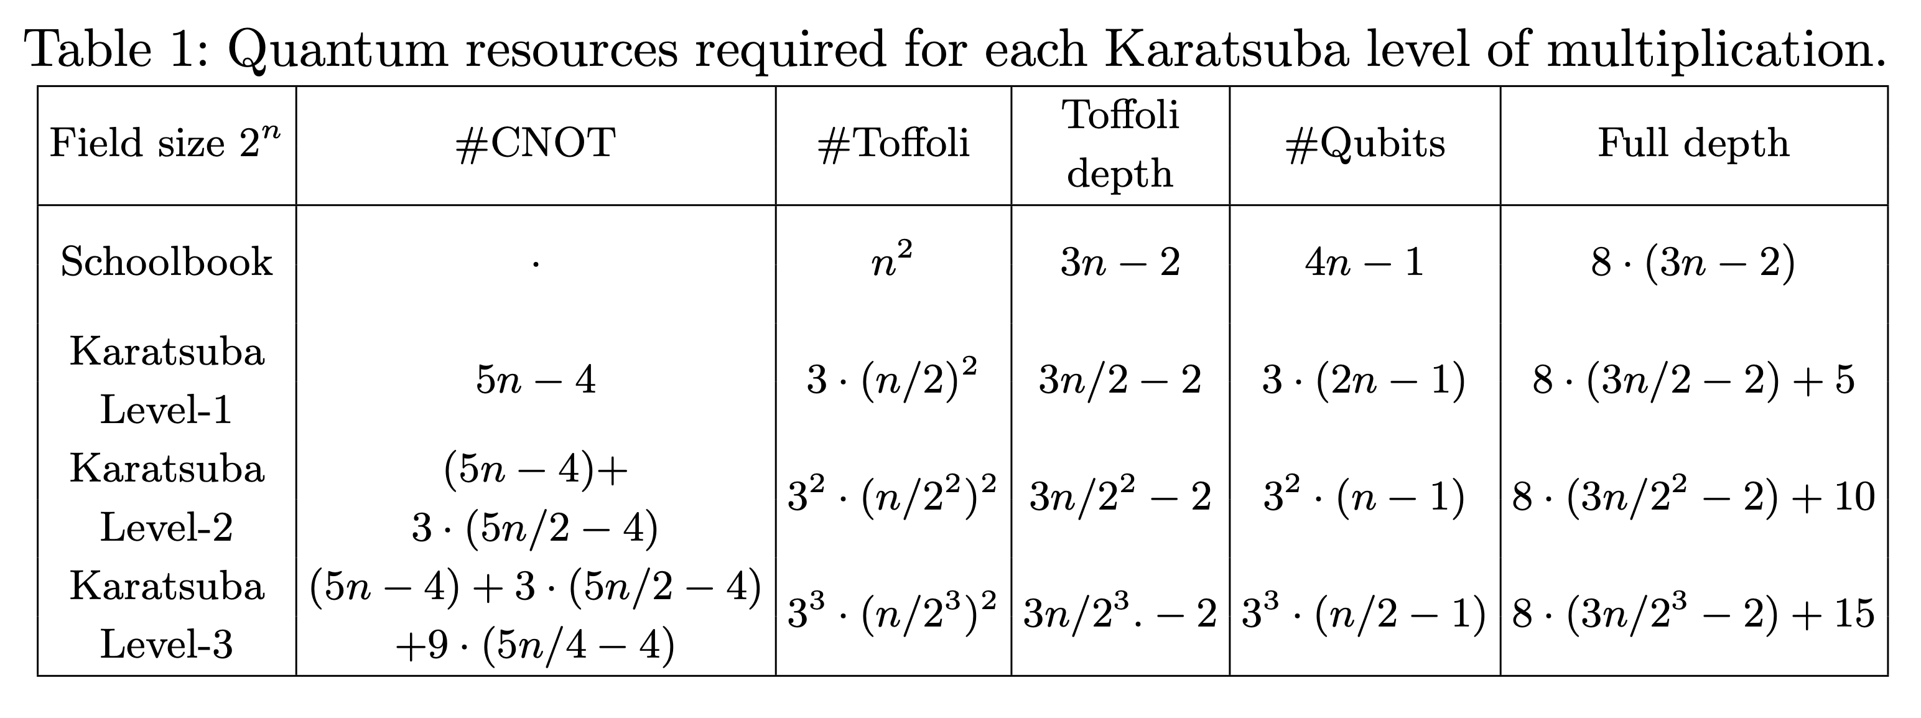
Proposed Quantum Binary Multiplication
Quantum resources are reduced according to the Karatsuba level (in our work)
Toffoli gates (depth) and Full depth are reduced
The number of qubits increases (because of rooms → ancilla qubits)

Slide 22
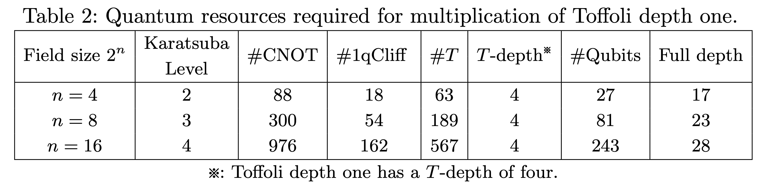
Proposed Quantum Binary Multiplication
High qubit count..
However, we overcome! (Let’s talk about later)
Optimized with Toffoli depth one, minimum Toffoli gates
Low full depth

Slide 23
Proposed Quantum Binary Multiplication
In our method, ancilla qubits that allocated each time the Karatsuba algorithm
is applied, which is obviously an overhead.
Recycling rooms (ancilla qubits)
After all products are generated at once in the last Karatsuba level, we initialize (cleaning) the rooms
Operations performed on rooms are reversed
From the lower layer to the upper layer
As a result, the ancilla qubits allocated for the rooms are initialized to zero!

Slide 24
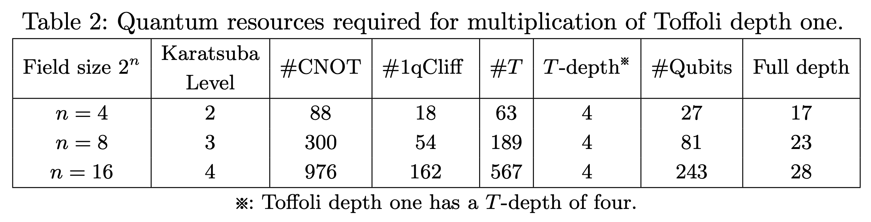
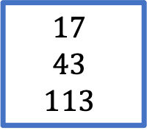
Proposed Quantum Binary Multiplication
The cleaned ancilla qubits can be reused in the next operation
→ Strong advantage
i.e., not stand-alone multiplication
e.g., Itoh-Tsujii based inversion, scalar multiplication, point addition on ECC…
Can be reduced
$$17$$
$$43$$
$$113$$

Slide 25
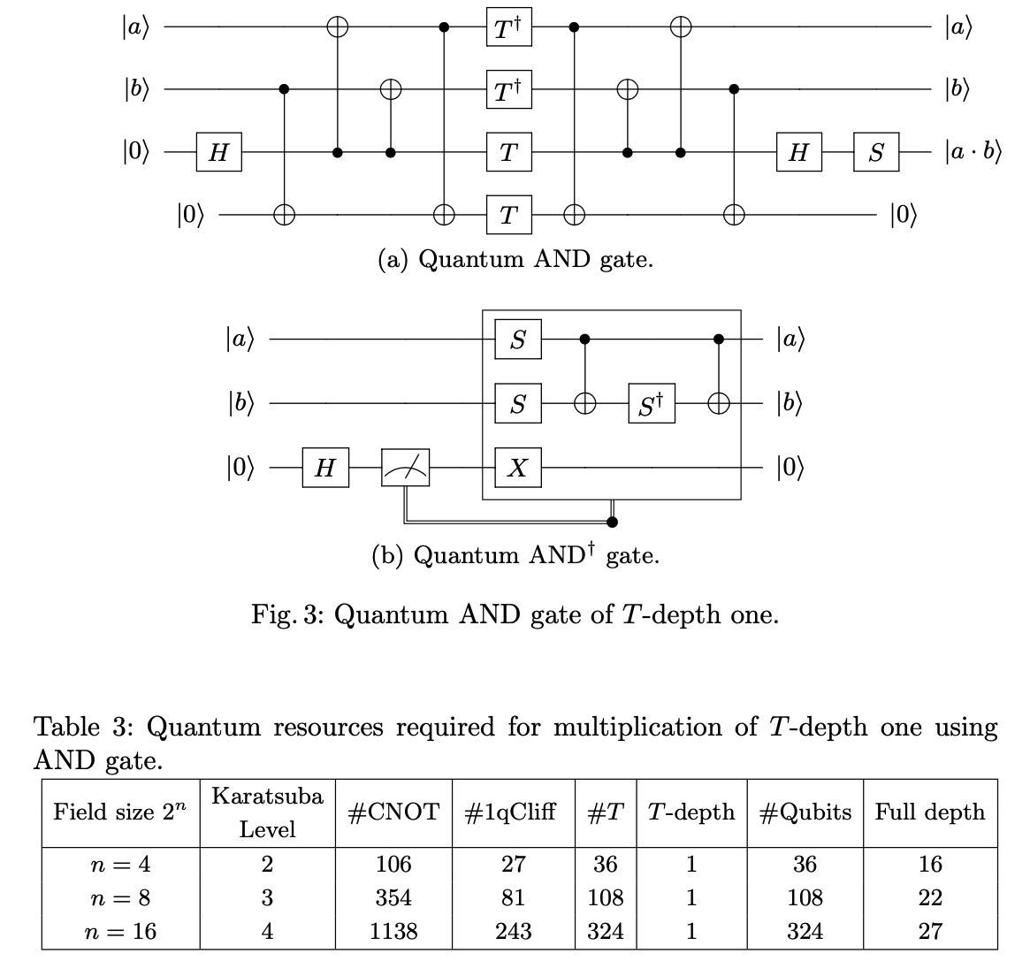
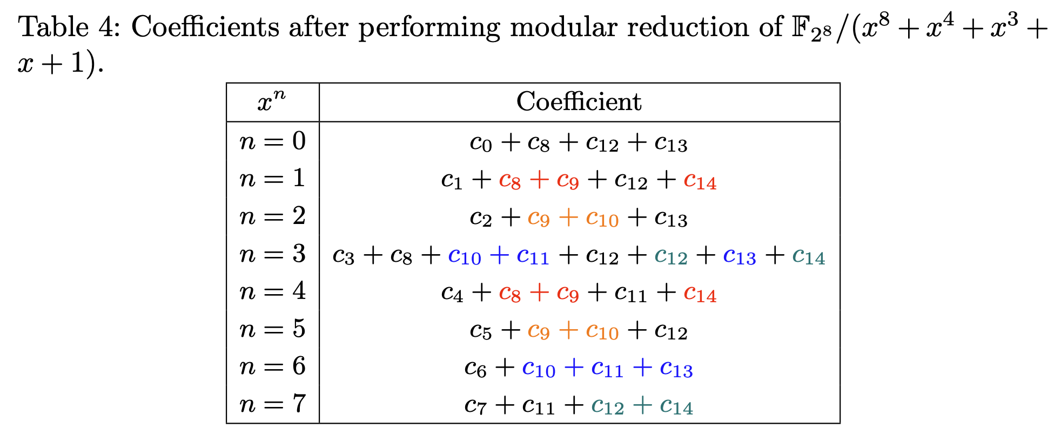
Proposed Quantum Binary Multiplication
Omitted from this presentation!
(detailed in the paper)

Slide 26
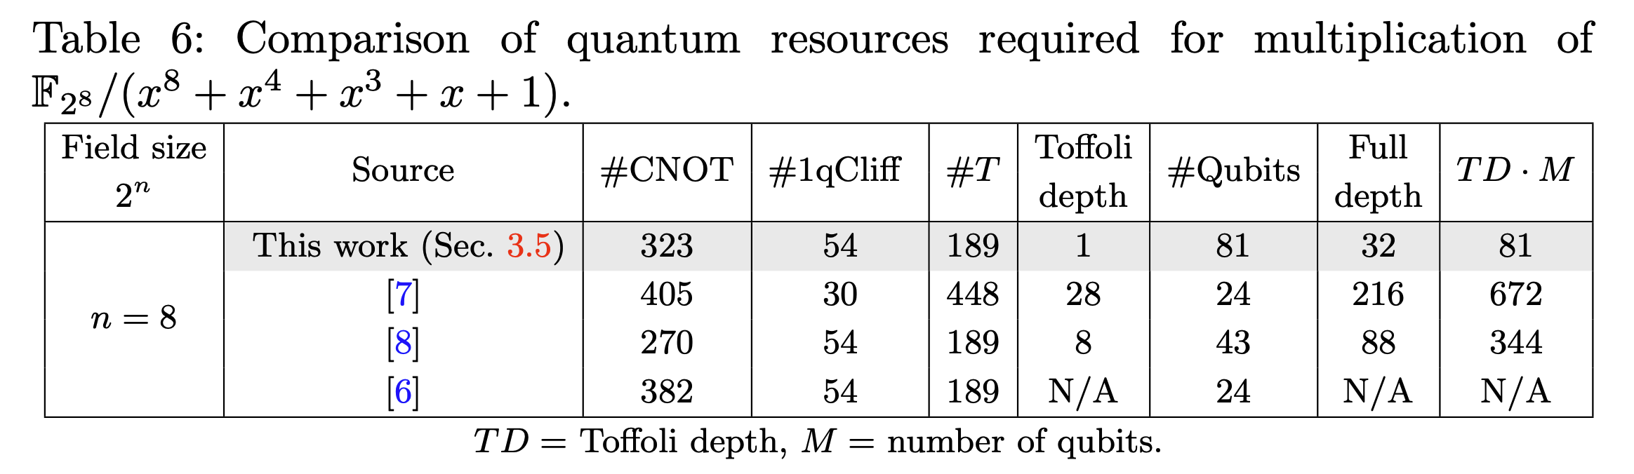
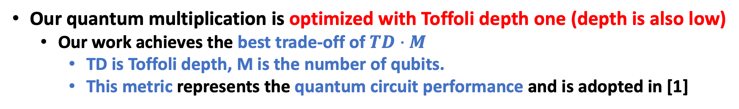
Performance
Our quantum multiplication is optimized with Toffoli depth one (depth is also low)
Our work achieves the best trade-off of $TD·M$
TD is Toffoli depth, M is the number of qubits.
This metric represents the quantum circuit performance and is adopted in [1]
Schoolbook
Karatsuba1
Karatusba2
[1] J. Zou, Z. Wei, S. Sun, X. Liu, and W. Wu, “Quantum circuit implementations of AES with fewer qubits,” in International Conference on the Theory and
Application of Cryptology and Information Security,

Slide 27
Conclusion & Future work
In this paper, we present an optimized quantum binary field multiplication
Main contribution is optimized with Toffoli depth one for any field size.
Further…
Recycling technique that offsets the overhead of qubits
Optimization with T-depth one
Efficient implementation of modular reduction.
Future work
Efficient quantum cryptanalysis (i.e., Shor) for ECC (binary)
In our understanding, quantum binary multiplication is paramount here
In CHES 2020 paper, Van hoof’s work was used

Slide 28
Thank you!

